Slide 1
环境搭建
参考配置
VMware12（及以上版本）
Ubuntu16.04（及以上版本）
教程http://jingyan.baidu.com/article/c275f6ba07e269e33d756714.html

Slide 2
课程交流
QQ群： 659846221

Slide 3
lab1-Data Lab Spring 2018
Due：Tues., Apr. 3, 11:59PM

Slide 4
1 Introduction
2 The Puzzles
2.1 Bit Manipulations
2.2 Two’s Complement Arithmetic
2.3 Floating-Point Operations
3 Evaluation

Slide 5
Introduction
The purpose of this assignment is to become more familiar with bit-level representations of integers and floating point numbers. You’ll do this by solving a series of programming “puzzles.”
Many of these puzzles are quite artificial, but you’ll find yourself thinking much more about bits in working your way through them.

Slide 6
The Puzzles
Some tips below:
bits.c is the file you will be working on
Read the instructions carefully – both in the bits.c file header and the lab writeup
You are expected to write C which follows ANSI C standards
Try and finish all puzzles before you set out to optimize your solution

Slide 7
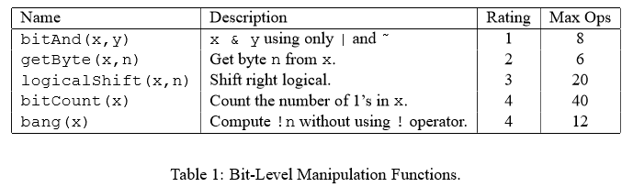
The Puzzles(Bit Manipulations)

Slide 8
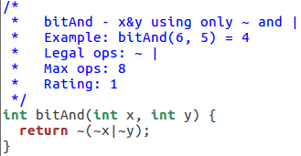
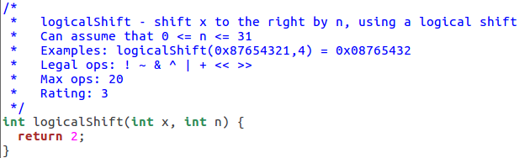
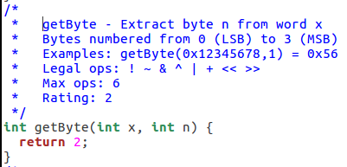
The Puzzles (Bit Manipulation)
1、bitAnd(x,y) 3、logicalShift(x,n)
2、getByte(x,n)

Slide 9
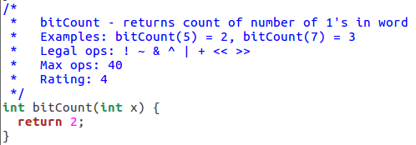
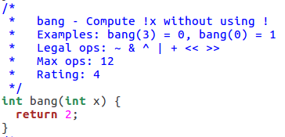
The Puzzles (Bit Manipulation)
4、Bitcount(x)
5、bang(x)

Slide 10
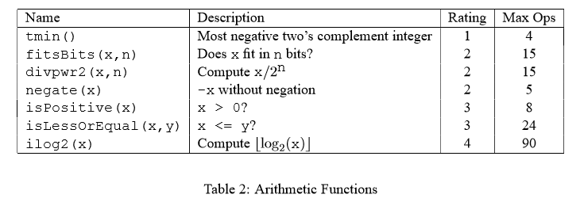
The Puzzles(Two’s Complement Arithmetic)

Slide 11
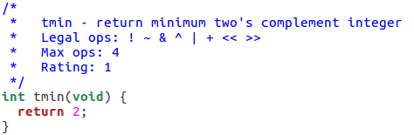
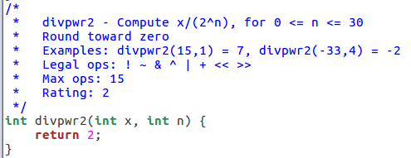
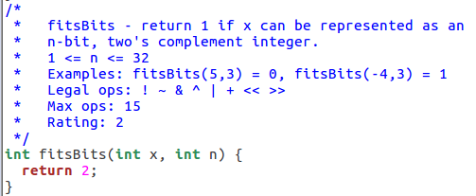
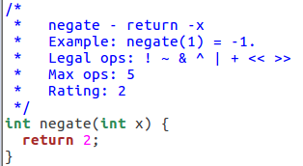
The Puzzles(Two’s Complement Arithmetic)
6、tmin() 8、divpwr2(x,n)
7、fitsBits(x,n)
9、negate(x)

Slide 12
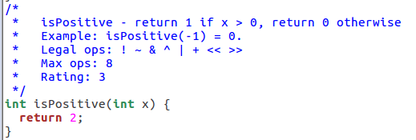
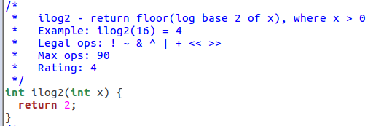
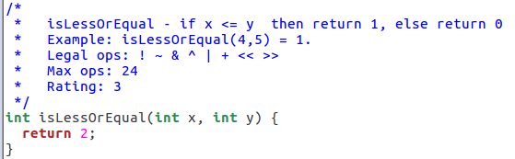
The Puzzles(Two’s Complement Arithmetic)
10、isPositive(x) 12、iLog2(x)
11、isLessOrEqual(x,y)

Slide 13
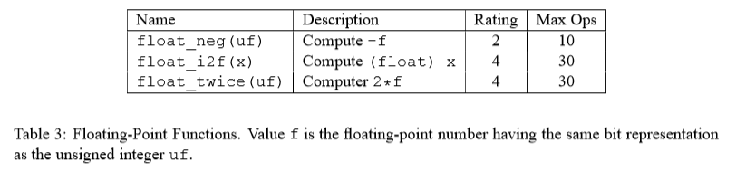
The Puzzles(Floating-Point operations)

Slide 14
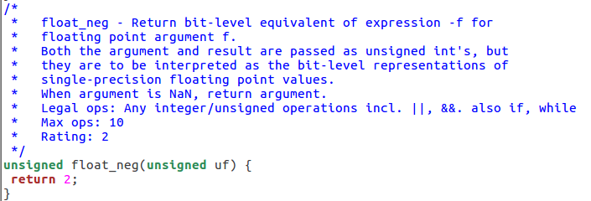
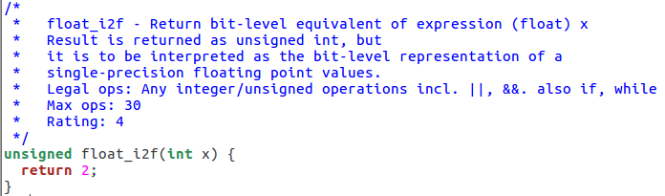
The Puzzles(Floating-Point operations)
13、float_neg(uf)
14、float_i2f(x)

Slide 15
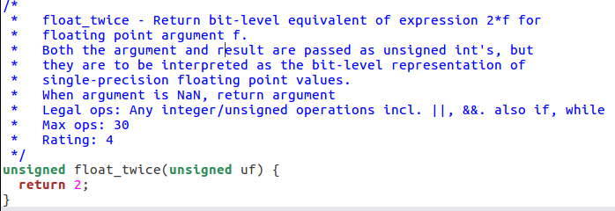
The Puzzles(Floating-Point operations)
15、float_twice(unsigned uf)

Slide 16
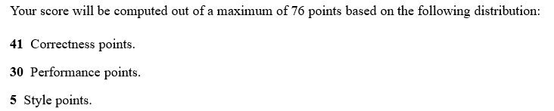
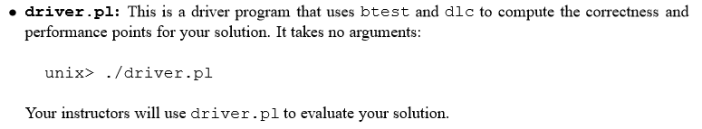
Evaluation

Slide 17
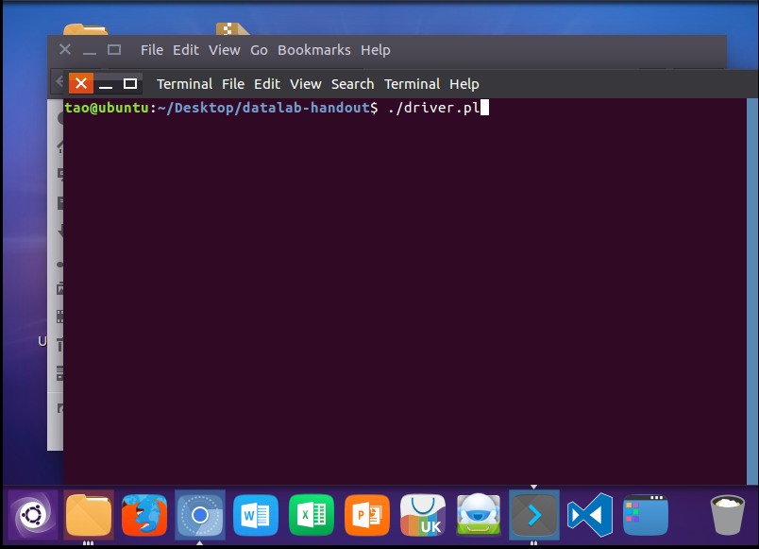
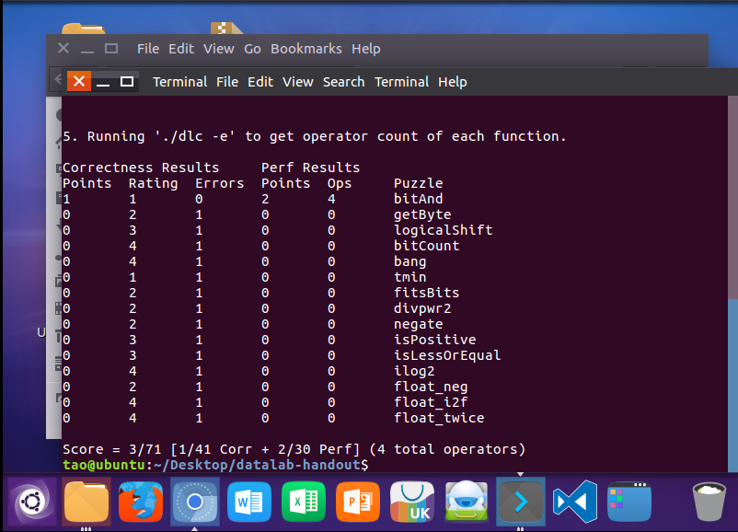
Evaluation

